Slide 1
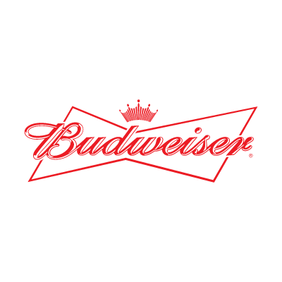

Final Report on Brewery and Beer Data Request
Customer: Budweiser
Consulting Team: Cameron Stewart and Adam Alidra

Slide 2
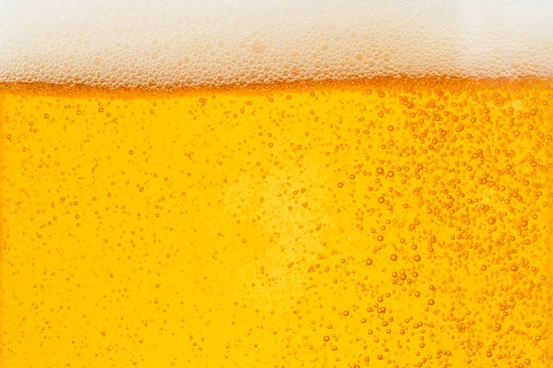

Agenda
Executive Summary
Breweries by State
Analyzing Missing Values
Median ABV & IBU by State
ABV Distribution and Maximum Values
ABV to IBU Relationship
Machine Learning – Predicting Beer Style
Summary, Proposal and Next Steps

Slide 3
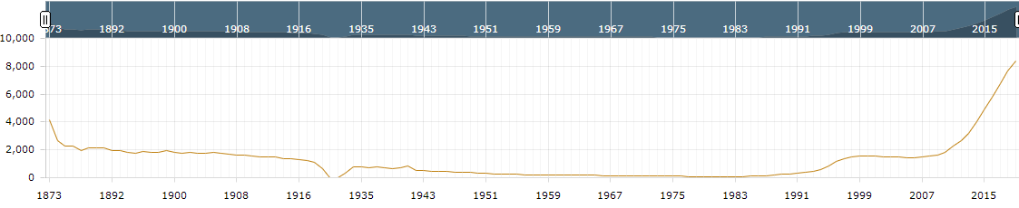
Executive Summary
Key Notes on provided Beer and Brewery Data Sets
The Breweries listed are all US Breweries and all Beers listed are Craft Beers
The data references 51 states (Washington D.C. included as a ‘state’)
High level findings on the broader US Brewery and Craft Beer Market from public data
U.S. Beer volume sales down 2% in 2019, while craft brewer sales continued to grow at rate of 4% by volume¹
Craft brewer sales reached 13.6% of the U.S. Beer market by volume¹
Historical U.S. Brewery Count¹
¹https://www.brewersassociation.org/statistics-and-data/national-beer-stats/#:~:text=Summary,grew%20the%20most%20for%20taprooms.

Slide 4
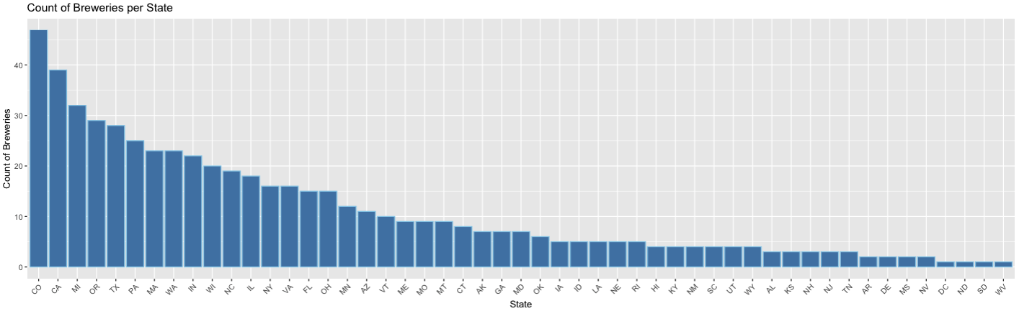
Breweries by State
Findings
558 Total Breweries listed in the Breweries data set
Top 25% of states contain over 60% of the Breweries
CO and CA have the most Breweries in total

Slide 5
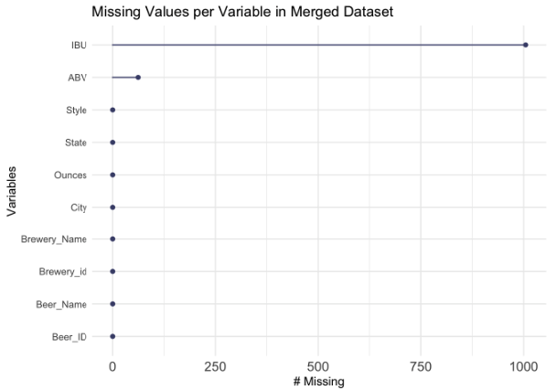
Analyzing Missing Values
Findings
No NA values in Breweries data set
Merged data sets produce a combined 1067 NA values (all of which are found in the Beer data set)
1005 NA values are from the IBU column
62 NA values are from the ABV column

Slide 6
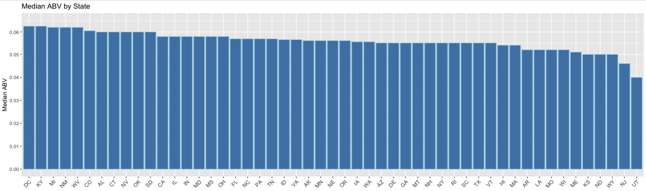
Median ABV by State
Findings
DC and KY are tied for the highest ABV at 6.25%
UT has the lowest median ABV by a significant margin at 4.00%
84% of states have a median ABV between 5% - 6% (inclusive)
Notes:
Mention ABV is Alcohol by volume and what values mean
Mention DC and KY are tied for the highest
The variation between most of the states is rather small
Indicated by 84% of the medians lie between 5-6%
Mention UT has the lowest (I would theorize cultural factors are driving this)

Slide 7
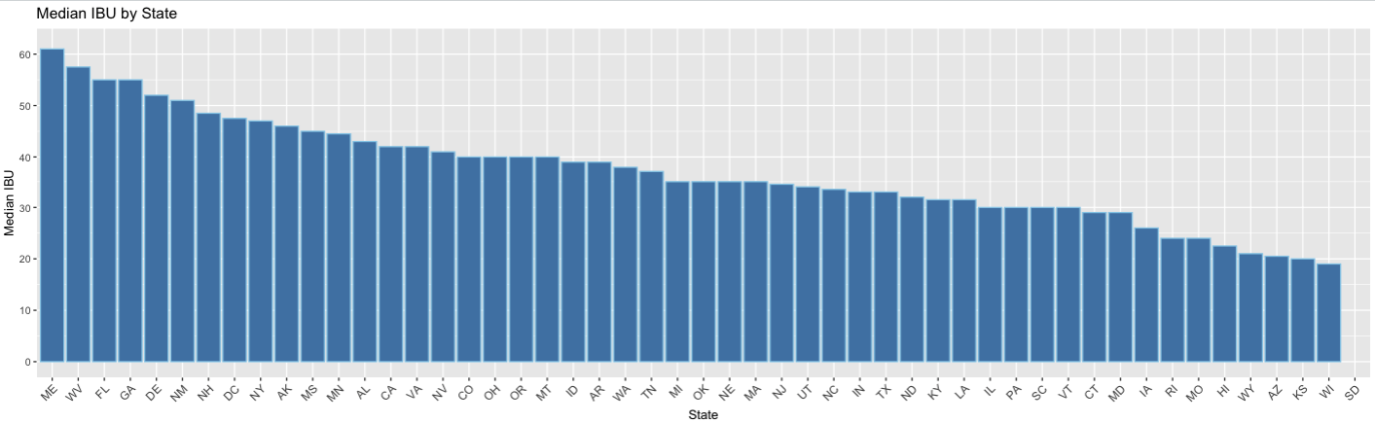
Median IBU by State
Findings
ME has the highest median IBU
WI has the lowest median IBU
SD has no IBU data in the provided data sets (shown without bar below)
Notes:
Mention IBU and what values mean
Looking at the data we can see ME has the highest IBU and WI has the lowest median
Overall we can see a steady decline from approximately an IBU of 60 to an IBU of 20
This data has a bit more range than ABV
SD NAs

Slide 8
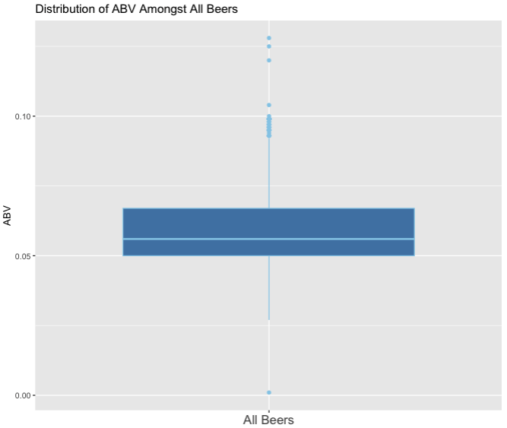
Maximum Values and ABV Distribution
Maximum Values for Individual Beers
Oregon’s Bitter Bitch Imperial IPA has the highest IBU of 138
Colorado’s Lee Hill Series Vol. 5- Belgian Style Quadrupel Ale has the highest ABV at 12.8%
ABV Distribution Findings
The box plot is slightly right skewed which signifies higher dispersion in ABV in Q3 and Q4
Median ABV amongst all analyzed Beers is 5.6%
There are significantly more outliers at the higher end of ABV than the lower end
Removed Beers with NA values in ABV
Notes:
Max values – what are they for
ABV Distribution
Box plot
Slightly right skewed with median of 5.6%
Outliers on upper end
Cluster of outliers around just below 10%

Slide 9
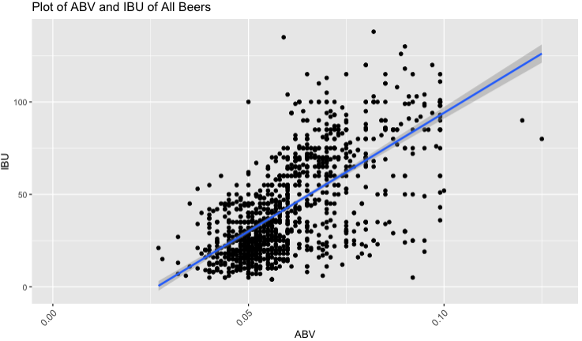
ABV to IBU Relationship
Findings
As ABV increases (x-axis), the IBU value (y-axis) also tends to increase showing a moderate relationship (R = 0.67)
45% of the variability in IBU can be explained by ABV (and vice versa)
Removed Beers with NA values in ABV or IBU
Notes:
Axis definitions
Positive trend
Moderate relationship based on the R-value 0.67
Using R^squared we know that 45% of the variability in IBU can be explained by ABV (and vice versa)
Beer style is another factor likely driving variation in these two factors

Slide 10
Machine Learning- Predicting Beer Style
Notes:
In this next section we apply two different, widely used machine learning models, kNN and NaiveBayes to ascertain insights respective to the ABV & IBU values of beers by style.

Slide 11
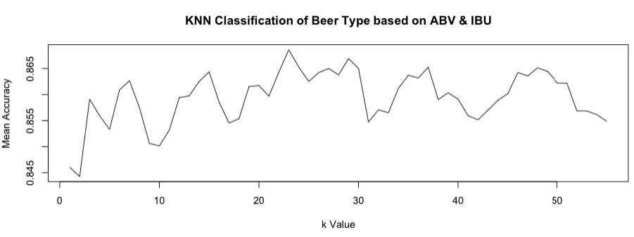
KNN Classification of Beer Types
KNN Classification Model
Predicting IPA to Other Ale based on ABV and IBU
Removed Non-Ale Beers (944 Beers remaining)
Tuned the model to find the ideal k of 23
Model Accuracy of 86.81% (1.49x Prior)
Prior probability of 58.4% (Assuming guess of Other Ale)

Slide 12
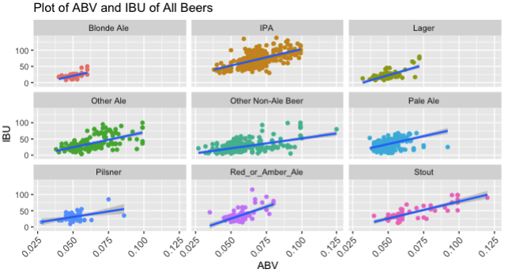
Naïve Bayes - Categorization of All Beers
Naïve Bayes
Predicting Beer Type based on ABV and IBU
Using only the 1403 beers with all information provided
70%/30% Training/Test Split
Model Accuracy of 44.99%(1.61x Prior)
Prior probability of 27.94% (Assuming guess of IPA)
Notes:
Blond Ales are consistently on the lower end of ABV with a few outliers stretching into higher ABV content
Pale Ale’s, Pilsner, and Lager’s also, by and large, appear to be on the lower end of ABV & IBU %’s with the exception of a few outliers, either extending to higher ABV, IBU, or both
Stouts on the other hand are the most sporadic in terms of expected ABV% albeit they appear to represent the smallest sample size of beers amongst types

Slide 13
Summary, Proposal, and Next Steps
Summary:
Linear relationship established between ABV and IBU
KNN offers an accurate model for Ale identification
Naïve Bayes offers an approach with increased granularity and flexibility
Proposal and Next Steps:
Utilize this analysis to understand the appropriate ABV and IBU range for each Style
Implement classification models to predict Beer style
Develop future project plans as more data is collected
Notes:
Based on the two Machine Learning models used, Naïve Bayes offers more upside by a predicting on more granular Beer Styles
The model offers flexibility to analyze varying points of interest other than Style as part of a broader study
Continued polarization both in the industry and socio-economically, along with consumer interest, in simply put, having options, reaffirms our recommendation to Budweiser, while continuing to focus on staple beer products, diversification , organically and/or inorganically by way of acquisitions, will be imperative to maintain a competitive edge against craft brewers while continuing to grab market share.
While not part of this study, it’s worth noting diversification is also occurring by way of introducing CBD, hard seltzer, and non-alcoholic products are a continuing trend, also areas A&C Data Consulting partners are well positioned to help you with

Slide 14
THANK YOU!
Youtube Link: https://www.youtube.com/watch?v=4Jq8AS1PUis

